Slide 1
Lotwize
Ryan Jewik

Slide 2
Problem Statement
Today the price of a property has never been higher, making the process of researching and buying a home the scariest it’s ever been. Lotwize wants to make that process a bit easier by providing a tool that can reliably evaluate the value of a property based on statistical home data. This allows the potential buyer to make informed decisions and have confidence that they are getting what they pay for.

Slide 3
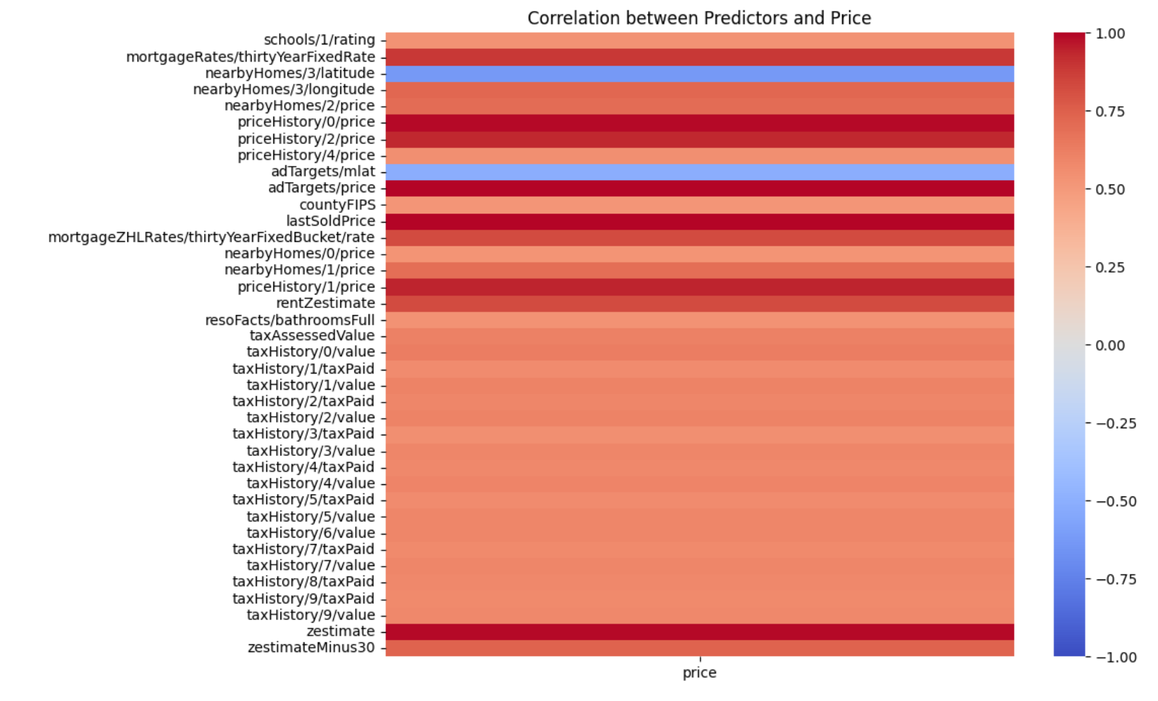
Preprocessing
Initially too many variables (356)
Took variables with correlation above 0.5 or under -0.5 to price
Also manually reviewed columns and explored
Data types
Unique values
Counts
Added additional variables such as:
Bathrooms
State
Square footage
Home type

Slide 4
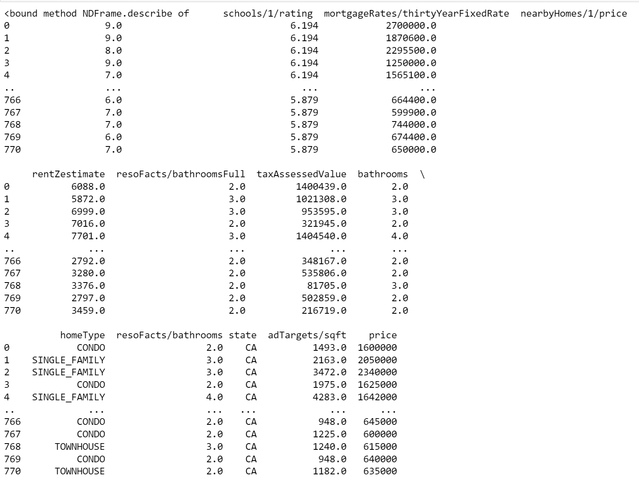
Feature Engineering and Selection
The bathroom variables were the same so we removed most of them
State was entirely California, no other states included in the data set
Other variables like price history were collinear with price
Ratings could have potentially been categorical however there’s a chance two schools could have the same rating

Slide 5
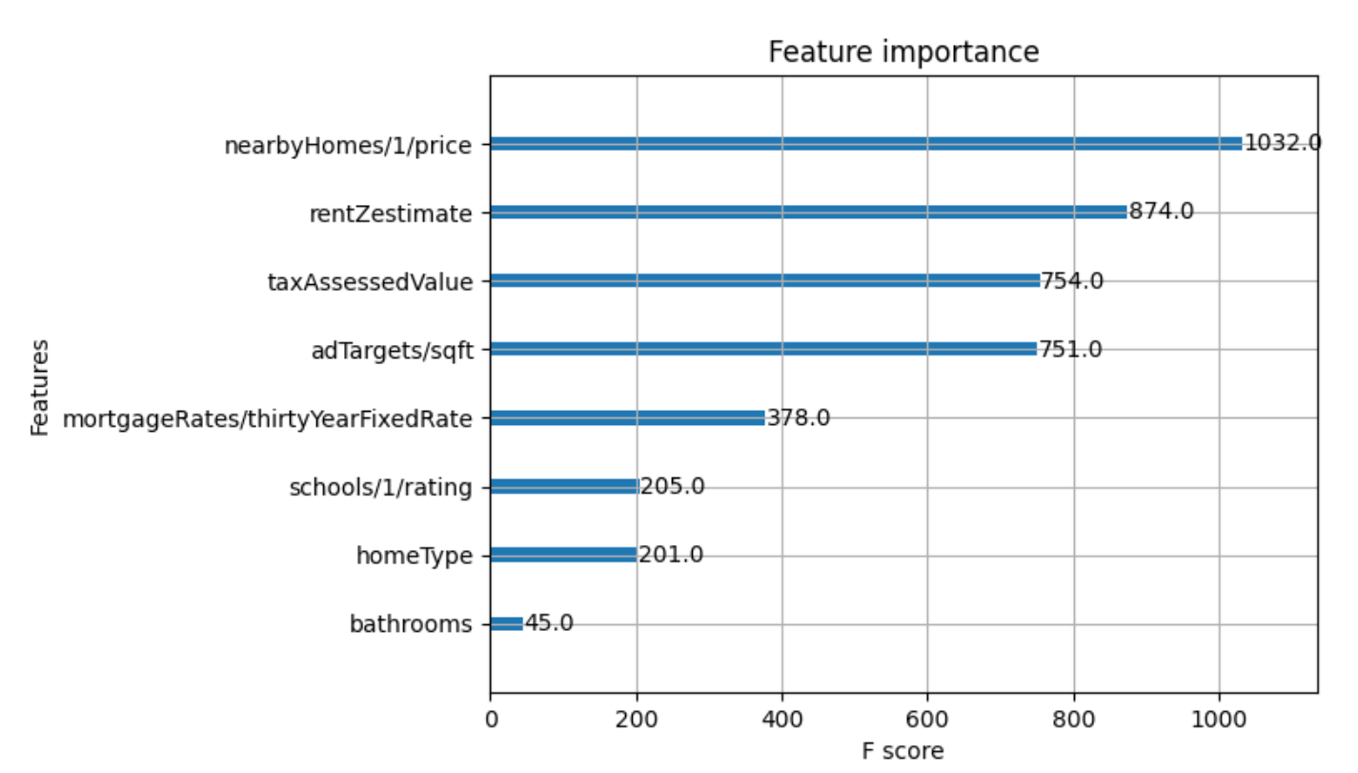
Problem Solving and Analytics
Other variables regarding price such as Rent Zestimate, nearby home prices, and price history were all highly important
Bathrooms and bedrooms proved to not be (relatively) important, likely because a large number of homes with wide price variances only have 2-3 bathrooms
Reduced features to 8 in final model

Slide 6
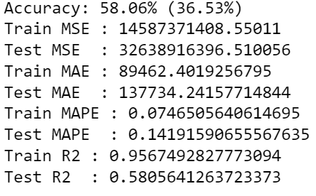
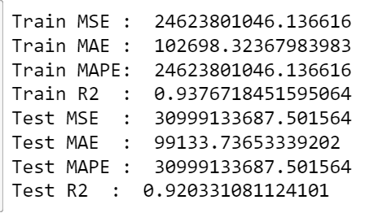
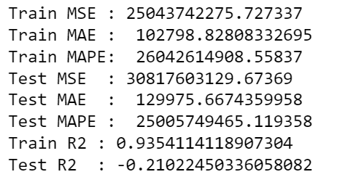
Predictive Modeling
Gradient Boosting Tree
K-fold cross validation
Due to overfitting reduced features
Used early stopping to find optimal hyperparameters
Still struggled with overfitting, likely due to features / data
Linear/Polynomial Regression
Additional polynomials worsen the results
Normal train test split showed good R2 but error values metrics were exceedingly poor
K-fold cross validation confirmed that
Train Test Split
K-Fold Cross Validation

Slide 7
Business Impact
In the interest of creating the best possible Automated Valuation Model, features centering around price such as nearby housing prices, tax assessed value, and mortgage rates have the highest importance in the model. Features that don’t very often and cannot be clustered well due to high variance such as bathroom count, bedroom count, and state don’t bring as much importance to the model.

Slide 8
Appendix
Used correlation graphs and filtered them to find important variables
Did additional manual analysis to pick out more variables that I thought to be potentially important
Initially began with polynomial regression, but soon found adding polynomials made the results significantly worse
one hot encoded categorical variables and z-scored continuous variables
Used MSE, MAE, MAPE, R2 as evaluation metrics
In an attempt to resolve overfitting issues with both the linear regression model and the gradient boosting tree, I used K-fold cross validation
Used Gradient Boosting Tree next but had similar (but not as drastic) overfitting issues
Used early stopping to find optimal hyperparameters and reduce overfitting
Used identical metrics to evaluate model
Tuned parameters using SHAP values and Feature Importance but it oversimplified the model

